Slide 1

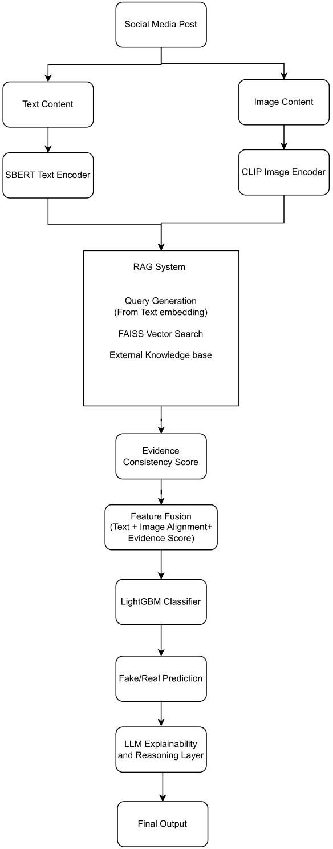
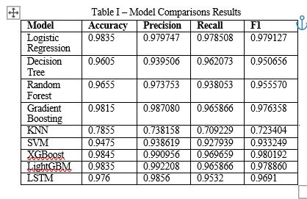
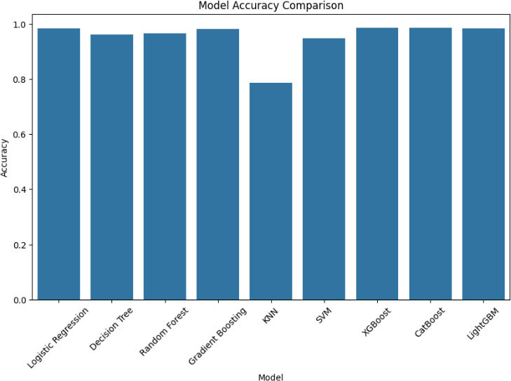
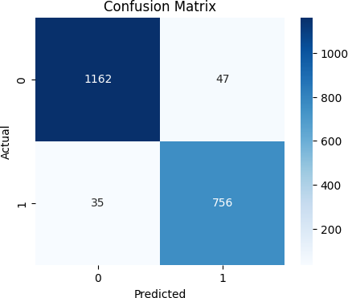
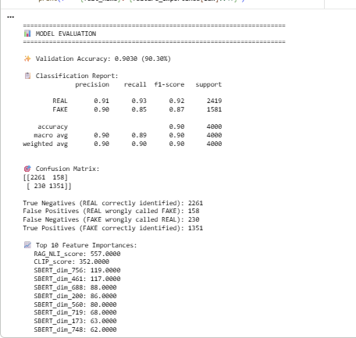
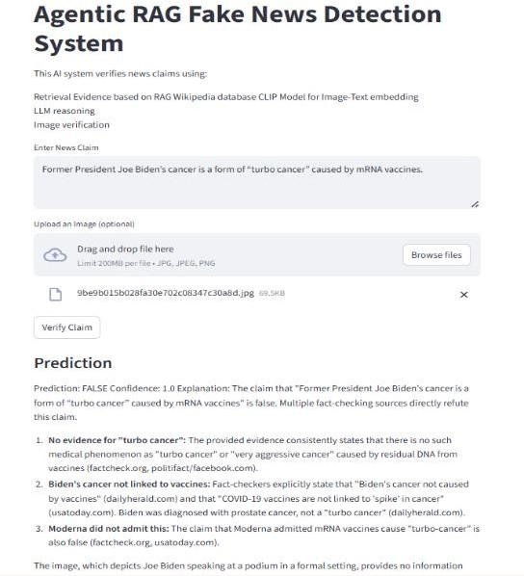



Evidence-Guided Multimodal Fake News Detection using Text-Image Consistency and External Knowledge
Introduction
School of Computer Science and Engineering – Winter Semester 2025 - 26
Social media has accelerated the spread of misinformation, where fake news often combines misleading text with manipulated or unrelated images. Traditional detection systems primarily rely on textual analysis and fail to verify claims using real-world evidence. This creates a gap in identifying credibility and providing explanations. To address this, a multimodal and evidence-driven approach is required for reliable fake news detection.
Results
The proposed evidence-guided multimodal framework was evaluated using the FakeReddit dataset with 20,000 samples. The system integrates textual, visual, and evidence-based features to improve classification performance.
The final prediction is obtained using the LightGBM ensemble model, expressed as:
$$\hat{y}=\sum_{m=1}^{M}{f_{m}}\left(x\right)$$
where $f_{m}\left(x\right)$represents the prediction from each decision tree and $M$is the number of trees. This allows the model to learn complex patterns from multimodal features.
RAG Retrieval Similarity
The retrieved evidence module identifies the most supporting evidence by comparing claim embedding with evidence embeddings stored in FAISS index.
The similarity between vectors is computed using Euclidean distance.
𝑑(𝑞, 𝑥𝑖) =∥ 𝑞 − 𝑥𝑖 ∥₂
Model Comparisons and Ablation study on Performance :
The ablation results highlight that the inclusion of RAG-based evidence retrieval contributes the most to performance improvement, while multimodal features further enhance accuracy.
The model achieved a validation accuracy of 90.30%, demonstrating strong capability in detecting both fake and real news. These results indicate that combining multimodal features with evidence retrieval significantly improves detection reliability.
Motivation
The rapid spread of misinformation on social media, especially through combined text and images, makes detection challenging and unreliable. Where most existing models classify content without verifying factual correctness or providing clear explanations. This motivated the development of an evidence driven system.
Scope of the Project
This project focuses on detecting fake news by analyzing both textual content with associated images using multimodal approach.
It incorporates external evidence retrieval to verify the credibility of claims and improve decision reliability.
The system is designed to provide not only predictions but also explanations supported by retrieved evidence and applicable to social media content and can be extended for real time and largescale misinformation detection
Methodology
This System Follows a structured multimodal pipeline that integrates textual understanding, visual verification and evidence – based verification combined with LLM Reasoning on basis of improving fake news detection reliability.
1. Textual Semantic Representation: The textual content of social media posts is processed using Sentence-BERT to generate dense semantic embeddings. This enables the system to capture contextual meaning and relationships between words, allowing accurate representation of the claim beyond simple keyword matching.
2. Image–Text Consistency Analysis: To ensure the reliability of visual information, the system uses CLIP to evaluate the alignment between textual claims and associated images. By computing similarity scores in a shared embedding space, the system identifies whether the image supports or contradicts the given text.
3. Evidence Retrieval using RAG: To validate the claim, a retrieval-based approach is employed where relevant documents are fetched from external knowledge sources. The SBERT embeddings are used as queries, and FAISS enables efficient similarity-based search to obtain supporting evidence.
4. Evidence Consistency Evaluation: The retrieved evidence is further analyzed using a Natural Language Inference model to determine whether it supports or contradicts the claim. This step produces an evidence consistency score, improving the credibility of the system’s decision.
5. Feature Fusion and Classification: All extracted features, including textual embeddings, image alignment scores, and evidence consistency, are combined into a unified representation. This is passed to a LightGBM classifier, which predicts whether the news is fake or real.
6. Explainability and Final Output: An LLM-based layer generates human-readable explanations using the retrieved evidence. The final output includes prediction, confidence, supporting evidence, and explanation, making the system both accurate and interpretable.
Conclusion
This work presents a multimodal fake news detection system that combines textual semantics, image–text consistency, and evidence verification. The integration of RAG and LightGBM improves reliability, while the explainability module enhances user understanding. The system demonstrates strong performance and practical applicability in real-world scenarios.
References
W. Benaouda, S. Ouamour, and H. Sayoud, “Comparison of CNN model with different machine learning models for fake news detection,” in Proc. Int. Conf. Electrical, Computer, Telecommunication and Energy Technologies (ECTETech), 2024, pp. 1–6.
M. K. Çoban and G. Bakal, “NLP-driven fake news detection: A machine learning perspective,” in Proc. Int. Congr. Human- Computer Interaction, Optimization and Robotic Applications (ICHORA), 2025, pp. 1–6.
Demo Video Link:
Student RegNo, Name: M.Hari Srinivas (24MCB0045)
Guide Name: Prof. Rakhi Mol V

